Slide 1
West Africa Center of Excellence for Data Science Research 2024 Annual Scientific Workshop Series
Introduction to artificial intelligence in the biomedical sciences
Jeffrey Shaffer, Ph.D.
May 12, 2024
Notes:
1

Slide 2
Outline
Introducing artificial intelligence (AI) and machine learning (ML)
Case studies

Slide 3
AI vs. ML
Artificial intelligence
Machine learning
AI – Tasks performed by machines ordinarily performed by humans.
Narrow, specific tasks
ML – Trained statistical models analyze data and identify patterns.

Slide 4
ML vs. Regular computing
Regular computing – provide computer with instructions or algorithms and tell it exactly what needs to be done.
Next, for example, make simple or complex computations.
ML – provide computer with training data and algorithms.
Next, for example, make predictions and produce output based on training data patterns.

Slide 5
White Box vs. Black Box Technologies
White Box (non-AI) – have operational rules that are completely understandable and yield predictable outputs.
Example: Computations with statistical packages.
White Box AI – interpretable, transparent learning algorithms.
Example: ML Regression
Black Box AI – More innovation and accuracy than White Box AI, but less transparency and interpretability.
Example: ChatGPT

Slide 6

Common AI/ML examples (guided exercise)
Chat bots
Chat GPT (Generative Pre-trained Transformer) – A text generator (an example of generative AI
or GenAI)
– An example of a black box algorithms

Slide 7
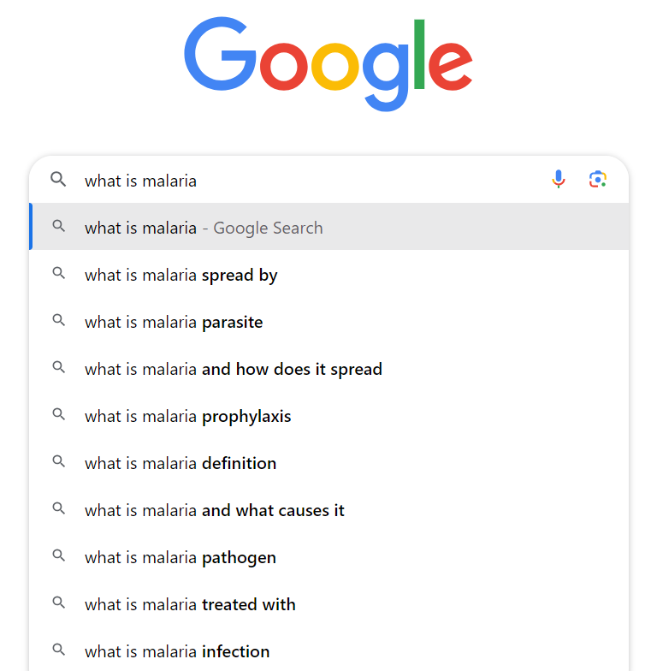
Common AI/ML examples
Search engines

Slide 8

Common AI/ML examples
Online translators

Slide 9

Common AI/ML examples
Voice assistants
Amazon Alexa

Slide 10
AI/ML in the biological sciences
“As more data become available for analytics, Richard Bellman's curse of dimensionality becomes apparent.”
ML/AI algorithms are even more suitable for datasets of large scale and high dimensions.

Slide 11


AI/ML in the biological sciences
Social media for outbreak prediction
Natural language processing
Optical character recognition
Old French School
J’ai voulu approcher…

Slide 12
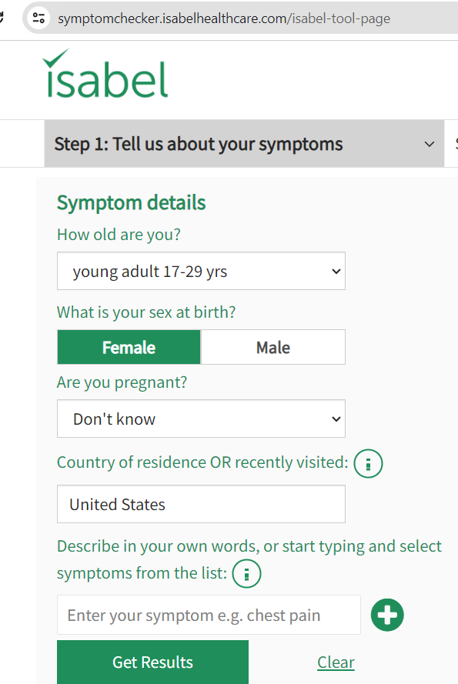
AI/ML in the biological sciences (guided exercise)
Symptom checkers

Slide 13
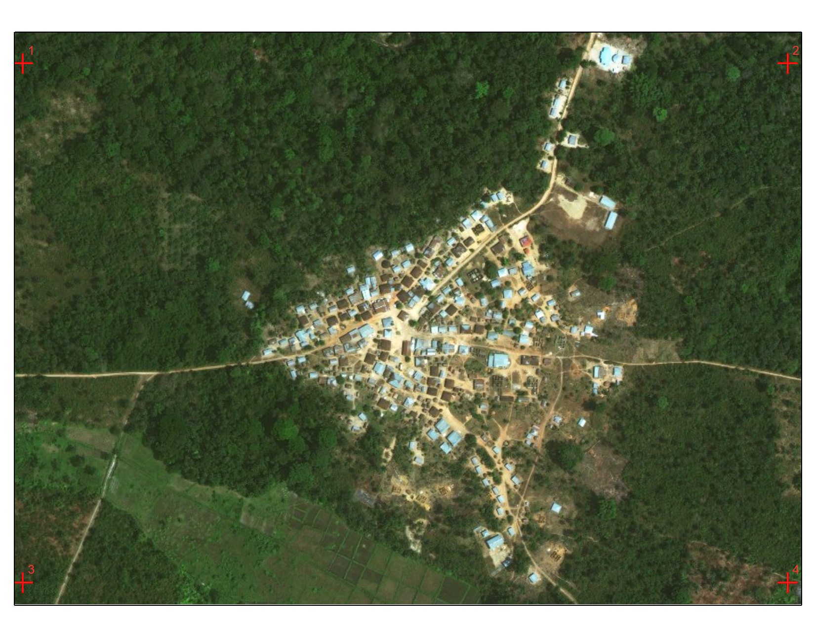
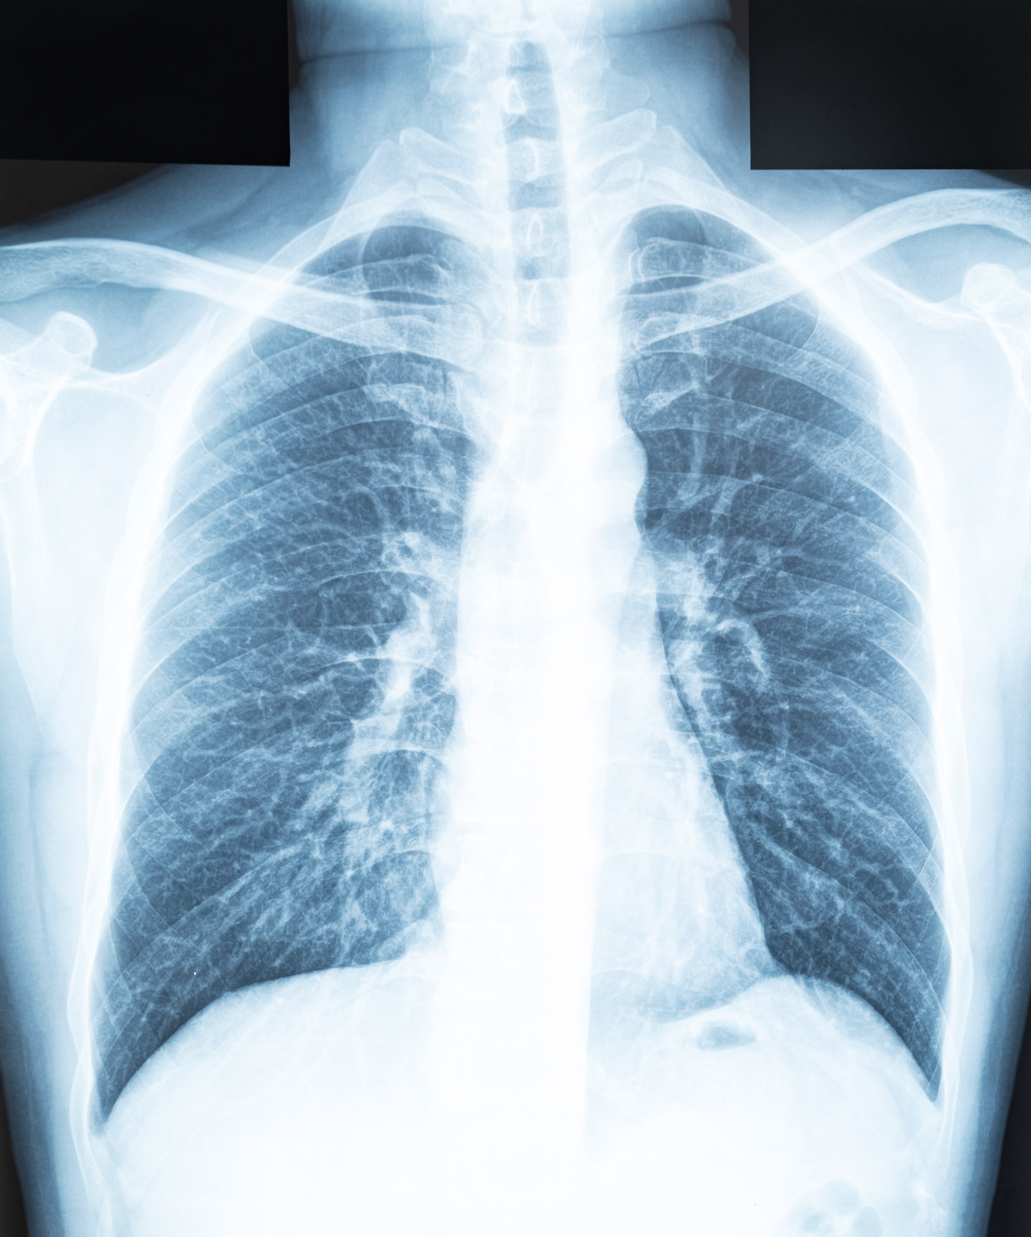
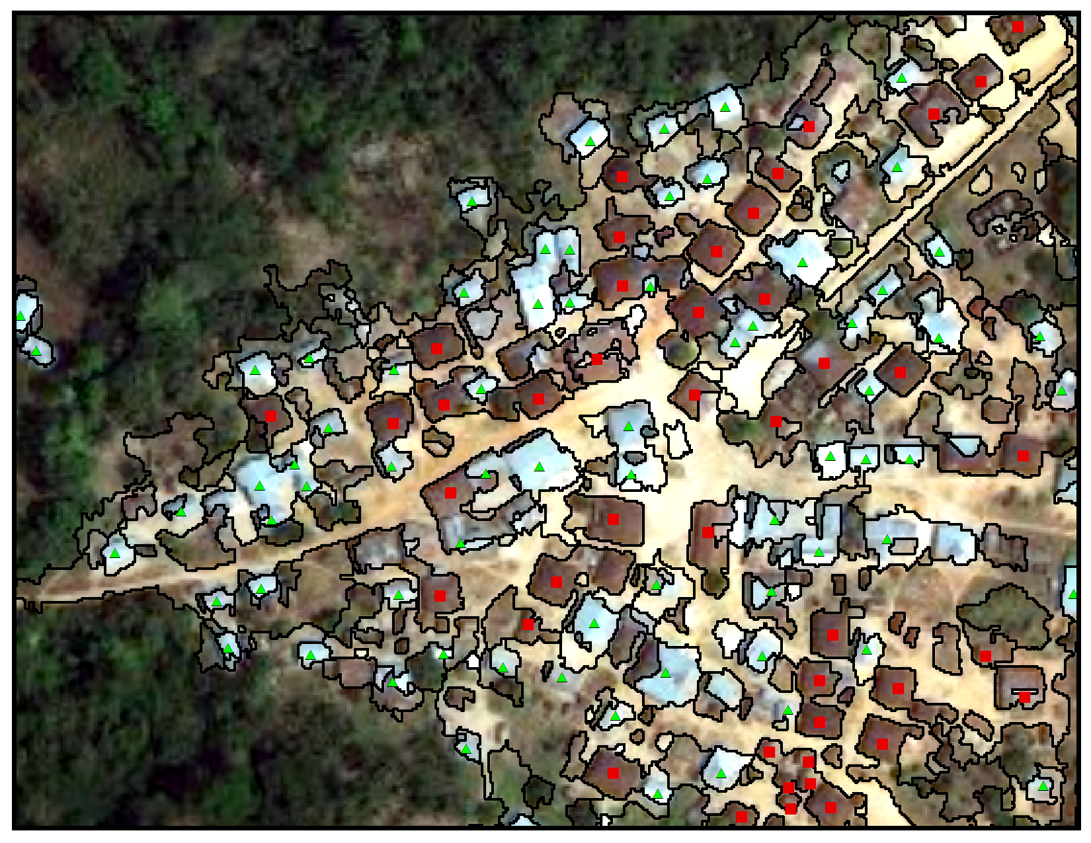
Satellite imagery analysis
AI/ML Examples in the biological sciences
Diagnostic imaging

Slide 14

AI/ML Examples in the biological sciences
Predictive analytics

Slide 15
Select traditional and AI/ML analogs
Characteristic | Traditional approaches | AI/ML
Starting points | Starting values, distributional assumptions | Training data sets
Sample size | Methodology available | Methodology not well-established.
Missing data | Often run with missing data | Usually requires complete data
Statistical significance | P values, confidence intervals | Usually not based on P values
Classification tables | Contingency tables | Confusion matrices
Prediction | Predictive modelling | Classification
xxxxxxxx
15

Slide 16
Select traditional and AI/ML analogs
Characteristic | Traditional approaches | ML/AI
Dimensionality | Lower-dimensional | Algorithms that learn from data, Training data sets
Data type | Simple to complex | Complex, multi-dimensional data (e.g., text recognition, imagery)
Focus | Hypothesis testing, parameter estimation | Prediction
Bias | Distributional or statistical test assumptions | Limited or non-representative training data

Slide 17
Traditional vs. AI/ML predictive models
Predictive models can be applied in traditional frameworks (like regression) or be rooted in machine learning.
The primary advantage of AI/ML predictive models is their capability to capture both linear and complex nonlinear relationships.

Slide 18
Two AI case studies
Linear regression
Satellite imagery segmentation

Slide 19
Think continuous dependent variable
Linear Regression
Objectives
Evaluate the strength & nature of the relationship between a single CONTINUOUS dependent variable and one or more independent variables
Predict the value of the dependent variable based on given values of one or more independent variables
Fit the “best” line to the data

Slide 20
Traditional vs. AI/ML Regression
Traditional machine learning models typically employ cross-validation using training and test data.
Cross-validation is a fundamental required tool in the machine learning community.
Almost all models that are considered machine learning predictive models focus on training or tuning parameters, which is almost impossible to do without cross-validation.

Slide 21
Training vs. Test data
Classifying a single data set into training and test data is known as splitting.
Why is it necessary to perform splitting?
We want our algorithm to learn correlations in our data and then to make predictions based on what it learned.
Splitting the data into two different sets ensures that our linear regression algorithm doesn’t overlearn.

Slide 22
Training vs. Test data
Training data portion is usually larger
80/20 or 70/30 splits are common

Slide 23
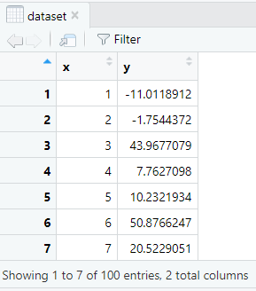
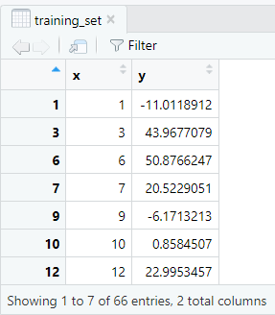
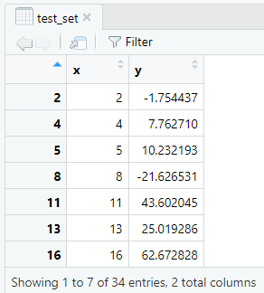
Full data set
Training portion (2/3)
Test portion (1/3)

Slide 24
Linear regression – Model evaluation
We can compare evaluation metrics for fitting the training and test data sets.
Root square mean error (RSME), lower is better
Underfitting models = high train RSME, high test RSME (performance poor for train and test; consider a more complex model)
Overfitting models = low train RSME, high test RSME (performance declines with test data; consider a simpler model)

Slide 25
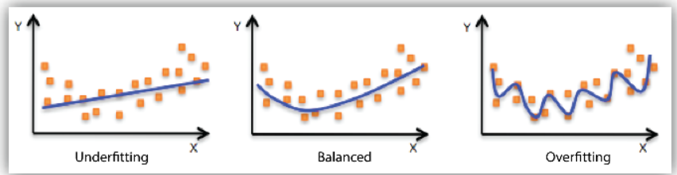
Linear regression – Model evaluation

Slide 26
Traditional vs. ML Regression
Linear regression also becomes ML when we apply decision-making automation to a dataset.
When we approximate a data model with a linear function that generally describes the data, we have applied linear regression and have identified a general pattern in the data.
If we use that pattern to drive decisions, we have applied learning.
When we automate the linear regression process and drive algorithmic decision making, we have applied machine learning.

Slide 27
Example: ML Linear Regression in R
Generate/import data
Perform traditional approach
Perform AI approach with split train/test data sets
Perform prediction
Evaluate model

Slide 28
Example: ML Linear Regression in R
Installation files
1. R (https://cran.rstudio.com/)
2. R Studio (https://rstudio.com/products/rstudio/download/#download)
3. Rtools (https://cran.r-project.org/bin/windows/Rtools/)

Slide 29
Linear regression – Generate sample data
# Simulate sample data set
set.seed(123)
x <- seq(from = 1, to = 100)
y <- rnorm(n = 100, mean = x + 2, sd = 25)
# Convert to dataframe
dataset <- data.frame(x, y)
# Generate scatter plot
library(ggplot2)
ggplot(data = dataset, aes(x = x, y = y)) +
geom_point(size = 3, color = "#0099f9") +
theme_classic() +
labs(
title = "Simple linear regression"
)

Slide 30
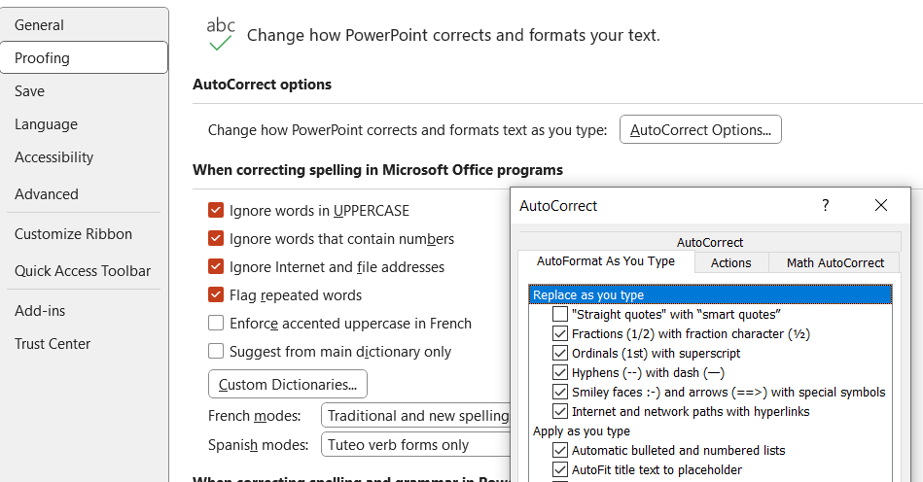
Linear regression – Generate sample data
Note: To copy snippets from PowerPoint (or another Microsoft Office application) to R,
File > Options > Proofing > AutoCorrect Options…
Uncheck "Straight quotes" with "smart quotes"

Slide 31
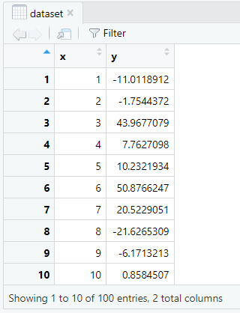
Linear regression – Generate sample data

Slide 32
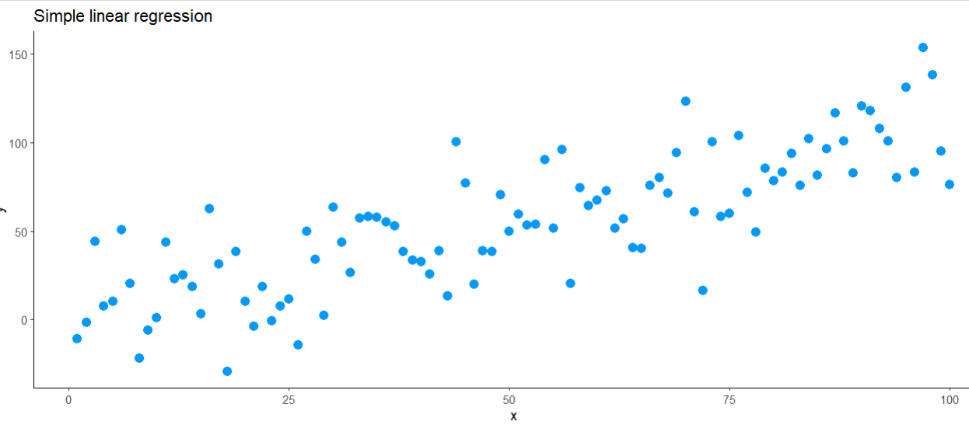
Linear regression – Generate sample data

Slide 33
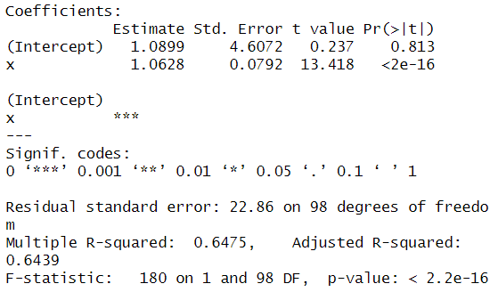
Linear regression – Generate sample data
Results below are for traditional regression and lack training/test data approach.
regressor = lm(formula = y ~ x, data = dataset)
summary(regressor)

Slide 34
Linear regression – Train/Test data sets
# Splitting the dataset into the Training and Test data sets
install.packages('caTools')
library(caTools)
set.seed(123)
split = sample.split(dataset$y, SplitRatio = 2/3)
training_set = subset(dataset, split == TRUE)
test_set = subset(dataset, split == FALSE)

Slide 35
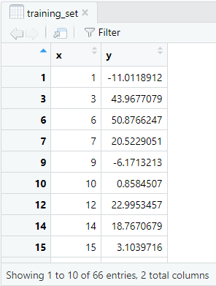
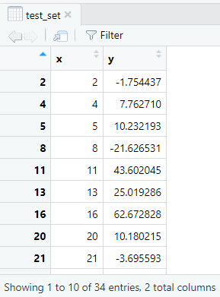
Linear regression – Train/Test data sets

Slide 36
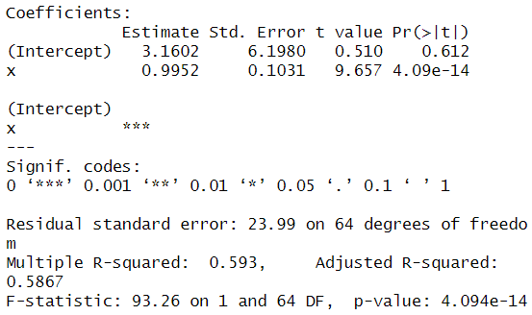
Linear regression – Training data set
regressor = lm(formula = y ~ x, data = training_set)
summary(regressor)

Slide 37
Linear regression – Visualizing training results
# Visualising the Training set results
library(ggplot2)
ggplot() +
geom_point(aes(x = training_set$x,
y = training_set$y),
colour = 'red') +
geom_line(aes(x = training_set$x,
y = predict(regressor, newdata = training_set)),
colour = 'blue') +
ggtitle('Y vs X (Training set)') +
xlab('X') +
ylab('Y')

Slide 38
Linear regression – Visualizing test results
# Visualising the Test set results
library(ggplot2)
ggplot() +
geom_point(aes(x = test_set$x, y = test_set$y),
colour = 'red') +
geom_line(aes(x = training_set$x,
y = predict(regressor, newdata = training_set)),
colour = 'blue') +
ggtitle('Y vs X (Test set)') +
xlab('X') +
ylab('Y')

Slide 39
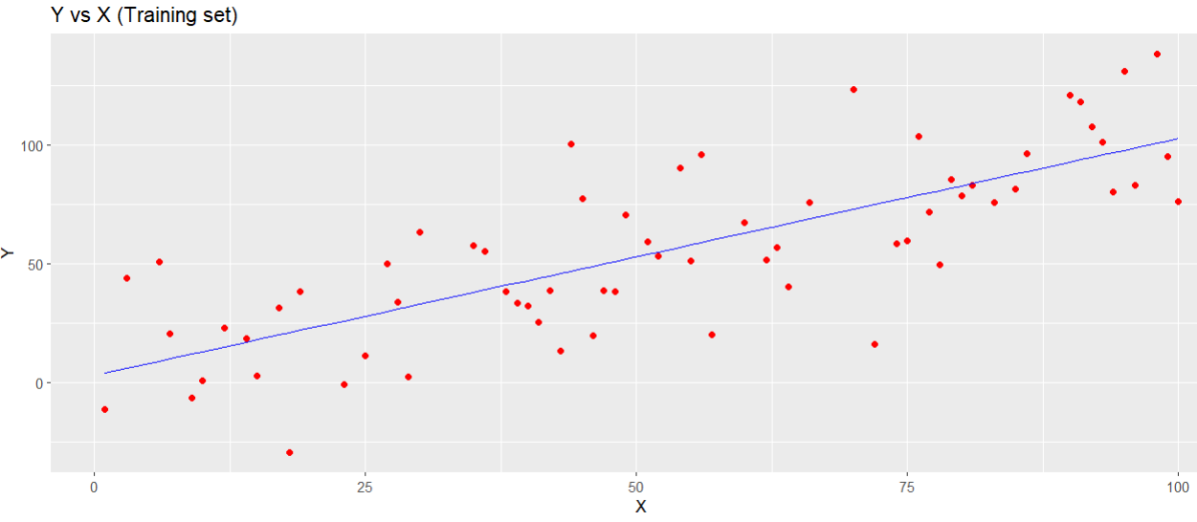
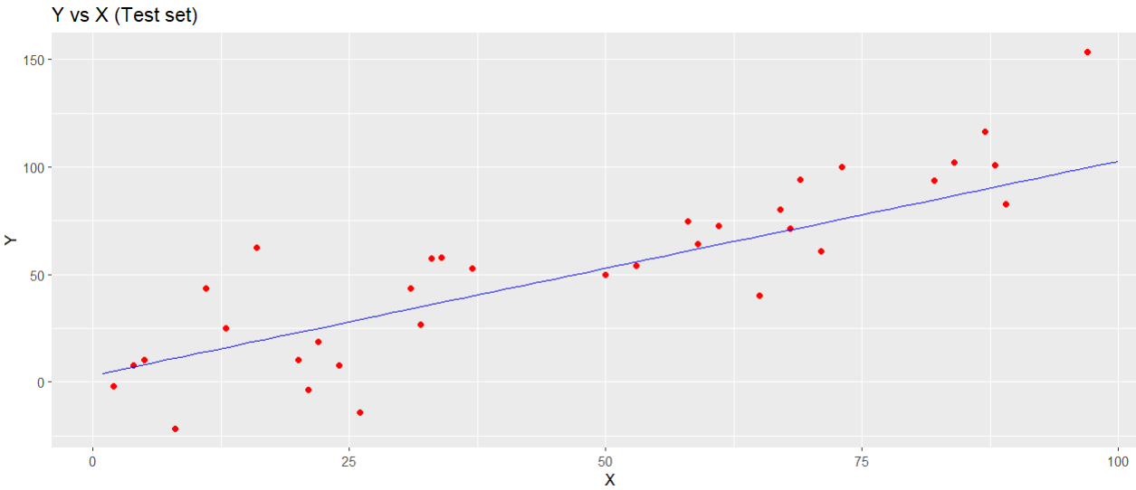
Linear regression – Visualizing results

Slide 40
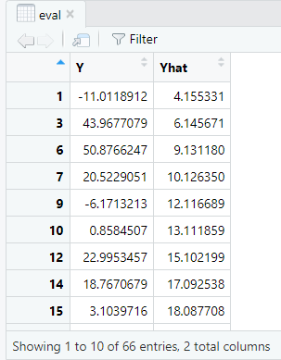
Linear regression – Generating RMSE
# Generating MSE for Training set
y_pred_tr = predict(regressor, newdata = training_set)
# Convert to dataframe
eval <- cbind(training_set$y, y_pred_tr)
colnames(eval) <- c("Y", "Yhat")
eval <- as.data.frame(eval)
head(eval)

Slide 41
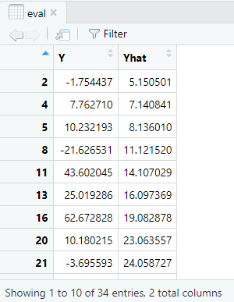
Linear regression – Making predictions
# Predicting the Test set results
y_pred_te = predict(regressor, newdata = test_set)
# Convert to dataframe
eval <- cbind(test_set$y, y_pred_te)
colnames(eval) <- c("Y", "Yhat")
eval <- as.data.frame(eval)
head(eval)

Slide 42
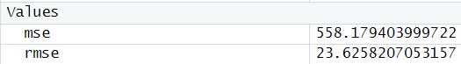
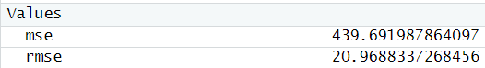
Linear regression – Evaluate models
# Evaluate training data model
mse <- mean((eval$Y - eval$Yhat)^2)
rmse <- sqrt(mse)
# Evaluate test data model
mse <- mean((eval$Y - eval$Yhat)^2)
rmse <- sqrt(mse)

Slide 43
Linear regression – Evaluate model
Training model
Test model
So, RSME for the test model < RSME for the training model.
These results suggest that the model is not overfit (i.e., is not overly complex)

Slide 44
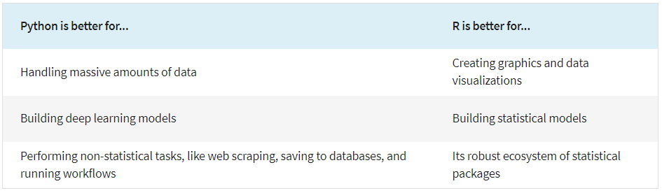
Comparing applications: Python vs. R

Slide 45
Linear regression – R full code
# Visualising the Training set results
library(ggplot2)
ggplot() +
geom_point(aes(x = training_set$x,
y = training_set$y),
colour = 'red') +
geom_line(aes(x = training_set$x,
y = predict(regressor, newdata = training_set)),
colour = 'blue') +
ggtitle(‘Y vs X (Training set)') +
xlab(‘X') +
ylab(‘Y')
# Visualising the Test set results
library(ggplot2)
ggplot() +
geom_point(aes(x = test_set$x, y = test_set$y),
colour = 'red') +
geom_line(aes(x = training_set$x,
y = predict(regressor, newdata = training_set)),
colour = 'blue') +
ggtitle(‘Y vs X (Test set)') +
xlab(‘X') +
ylab(‘Y')
setwd("C:/Users/…/Desktop")
# Importing the dataset
dataset = read.csv(‘dataset.csv')
# Splitting the dataset into the Training set and Test set
install.packages('caTools')
library(caTools)
set.seed(123)
split = sample.split(dataset$y, SplitRatio = 2/3)
training_set = subset(dataset, split == TRUE)
test_set = subset(dataset, split == FALSE)
# Fitting Simple Linear Regression to the Training set
regressor = lm(formula = y ~ x,
data = training_set)
# Predicting the Test set results
y_pred = predict(regressor, newdata = test_set)

Slide 46
Linear regression – full Python code
# Importing the libraries
import numpy as np
import matplotlib.pyplot as plt
import pandas as pd
# Importing the dataset
dataset = pd.read_csv(‘dataset.csv')
X = dataset.iloc[:, :-1].values
y = dataset.iloc[:, 1].values
# Splitting the dataset into the Training set and Test set
from sklearn.cross_validation import train_test_split
X_train, X_test, y_train, y_test = train_test_split(
X, y, test_size = 1/3, random_state = 0)
# Fitting Simple Linear Regression to the Training set
from sklearn.linear_model import LinearRegression
regressor = LinearRegression()
regressor.fit(X_train, y_train)
# Predicting the Test set results
y_pred = regressor.predict(X_test)
# Visualising the Training set results
plt.scatter(X_train, y_train, color = 'red')
plt.plot(X_train, regressor.predict(X_train), color = 'blue')
plt.title(Y vs X (Training set)')
plt.xlabel(‘X')
plt.ylabel(‘Y')
plt.show()
# Visualising the Test set results
plt.scatter(X_test, y_test, color = 'red')
plt.plot(X_train, regressor.predict(X_train), color = 'blue')
plt.title(‘Y vs X (Test set)')
plt.xlabel(‘X')
plt.ylabel(‘Y')
plt.show()

Slide 47
Case 2: AI approaches for analyzing satellite imagery
Access satellite imagery (ArcGIS Online)

Slide 48
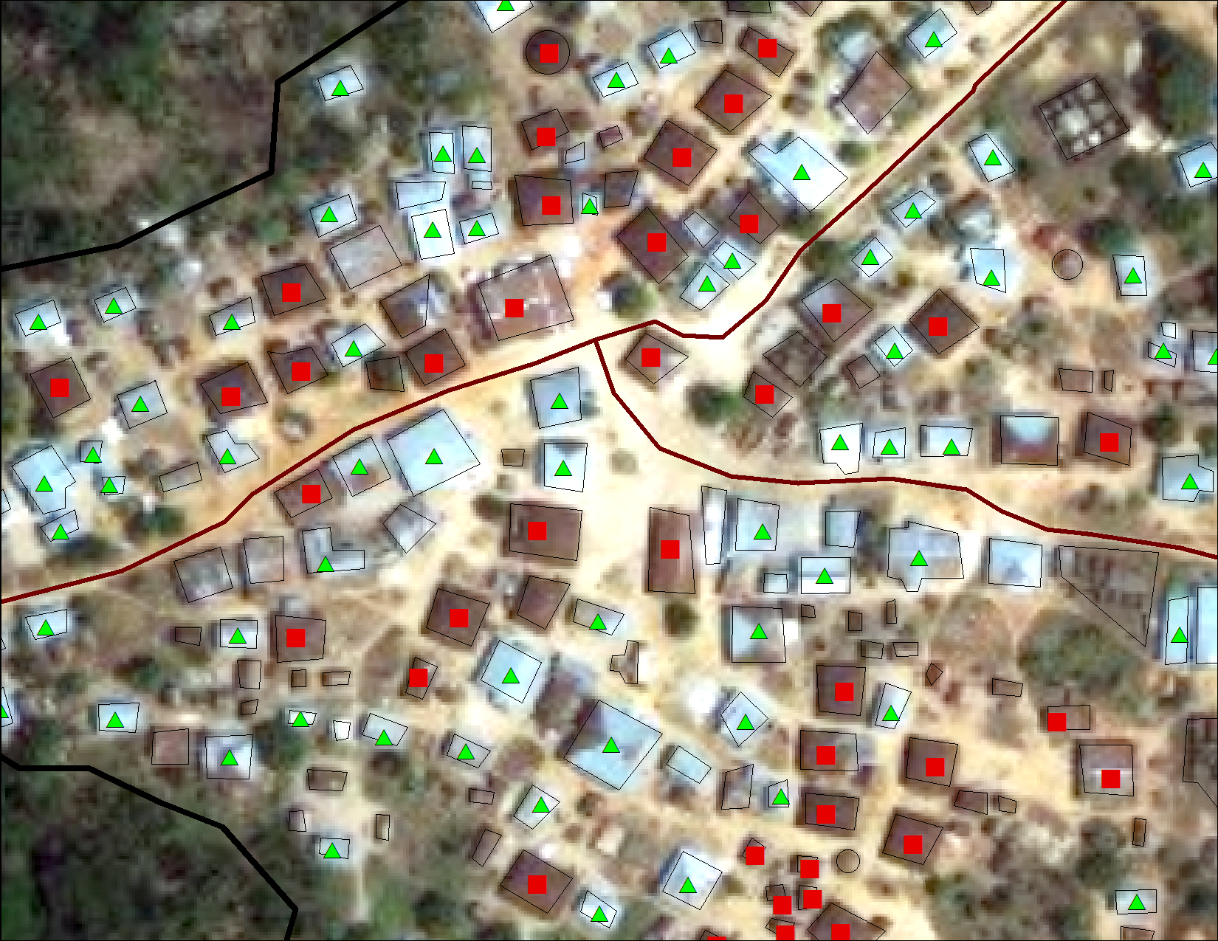
Case 2: AI approaches for analyzing satellite imagery
2. Manually digitize housetops using QGIS or ArcGIS

Slide 49
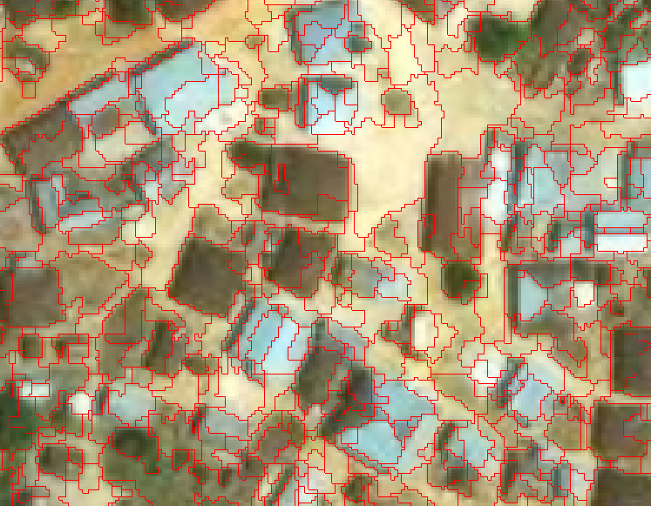
Case 2: AI approaches for analyzing satellite imagery
3. Define training data using imagery analysis software (ENVI).
4. Perform automated segmentation using ENVI.

Slide 50
Conclusions
Use of AI/ML will accelerate and is likely the future of many traditional analytical approaches.
A hallmark of AI/ML is training data.
AI/ML can account for multi-dimensional aspects that cannot be done using traditional methods.
Comparing with traditional methods is a logical and effective learning approach.

Slide 51
Thank You!

